Slide 1
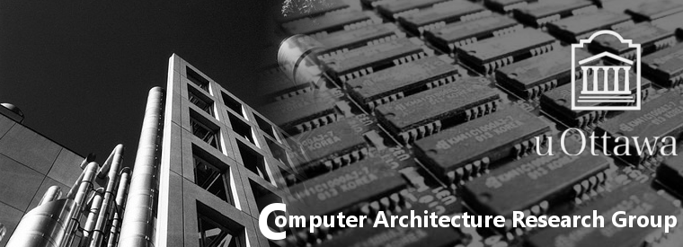
Introduction to Virtualization and Xen
Wei Wang
Computer Architecture Research Group,
University of Ottawa, Ontario, Canada

Slide 2
Virtualization

Slide 3

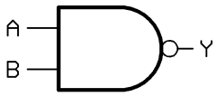
Concepts
Conceptually similar to emulation
The underlying hardware resources are shared by multiple virtual machines
carg.site.uottawa.ca

Slide 4
Hypervisor
Also known as a virtual machine monitor(VMM), which is the key component in virtualization
Running with higher privilege level than OSes
Responsible for isolating each running instance of an OS from the physical machine
Guaranteeing that OSes do not interfere with one another
carg.site.uottawa.ca

Slide 5
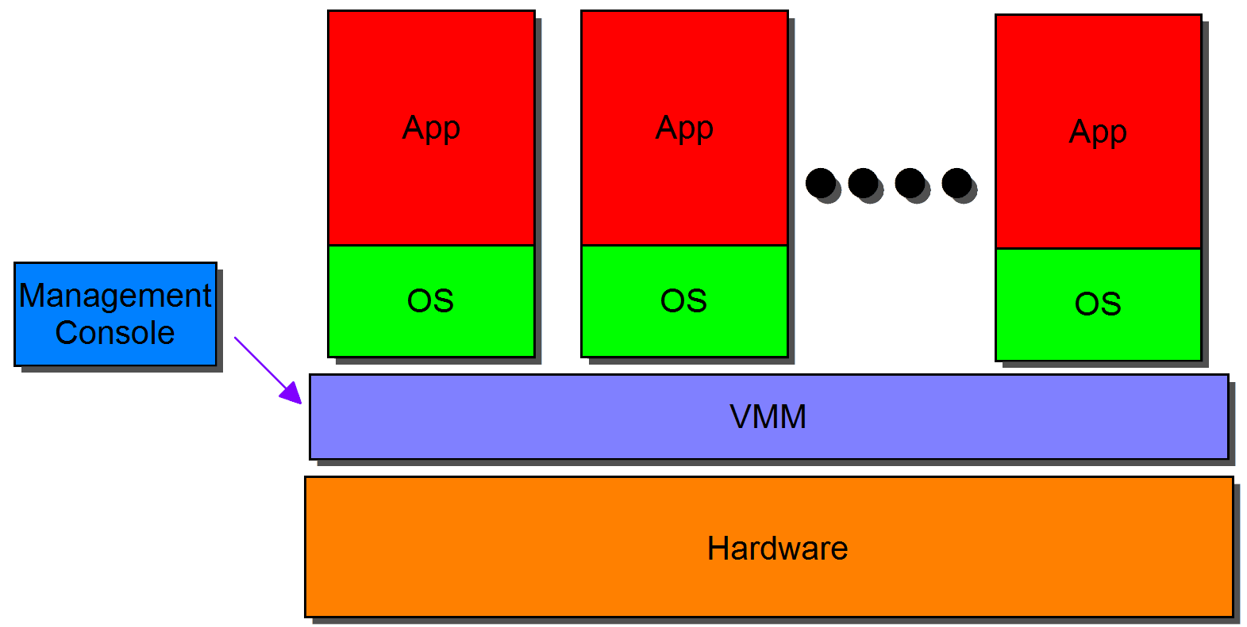
Type 1 Hypervisor
Known as bare metal hypervisor
Example: Xen
xm create …
xm console …
……
carg.site.uottawa.ca

Slide 6
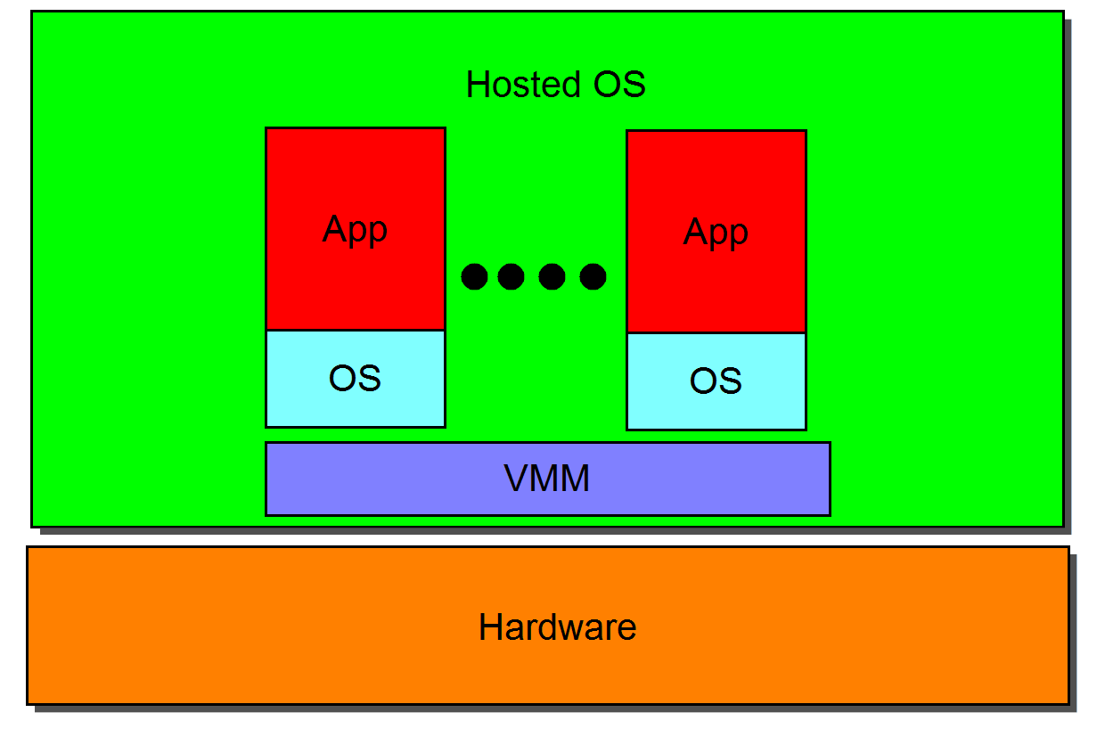
Type 2 Hypervisor
Known as hosted hypervisor
The hosted OS provides device drivers
Less efficient than Type 1 Hypervisor
Example: VMware workstation, KVM
carg.site.uottawa.ca

Slide 7
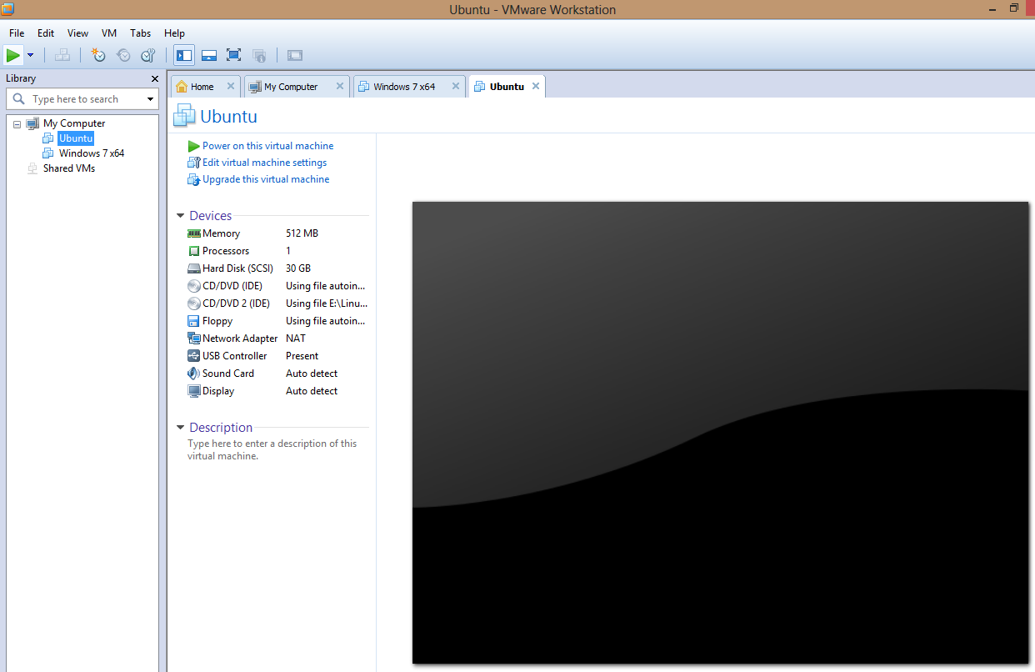
VMware Workstation 8.0 GUI

Slide 8
Benefits of Virtualization
Reduce the number of hardware machines
Increase hardware utilization
Facilitate OS migration
Virtualization
carg.site.uottawa.ca

Slide 9
Virtualization Requirements -Popek and Goldberg
Privileged instructions
Those that trap if the processor is in user mode and do not trap if it is in
system mode
Examples: instructions which intend to change the value of a control
register, like CR2.
Control sensitive instructions
Those that attempt to change the configuration of resources in the
system
Examples: CLI, which intends to clear the interrupt flag.
Behavior sensitive instructions
Those whose behavior or result depends on the configuration of
resources
Examples: INT N, which calls the Nth interrupt handler.
carg.site.uottawa.ca
Notes:
any instructions that change the state of the machine in a way that impacts other processes should be able to be intercepted by the hypervisor

Slide 10
x86 Virtualization
Notoriously difficult to virtualize, since 17 sensitive instructions are non-trappable
Examples: popf
Solutions:
Full virtualization (unaware of virtualization)
Paravirtualization (aware of virtualization)
Hardware Assisted Virtualization (a type of full virtualization)
carg.site.uottawa.ca

Slide 11
VMware Binary Translation
Translation happens at runtime, interleaved with execution of the generated code
Pick out privileged instructions, and translate them into user mode instructions
Uses a code cache to store translated blocks of code for reuse.
Input is binary x86 code and output is usually also binary x86 code, so most instructions remain the unchanged
carg.site.uottawa.ca

Slide 12
Binary Translation Examples
One Translation Unit (TU):
One Compiled Code Fragment (CCF):
push %ebx
mov %eax,%edx
cli
mov $1,%ecx
xor %ebx,%ebx
jmp doTest
push %ebx
mov %eax,%edx
and 0xfd,%gs:vcpu.flags
mov $1,%ecx
xor %ebx,%ebx
jmp [doTest]
In real implementation, binary code is used instead of the above assembly code, for example: 89 f9 be 02 00 00 00 39 ce 7d …
carg.site.uottawa.ca

Slide 13
Paravirtualization
Proposed in 2003 by researchers from Computer Laboratory at University of Cambridge
OSes need to be modified to run over a hypervisor
An OS uses hypervsor supplied APIs to request the hypervsor to perform priviledged operations in behalf of the OS
carg.site.uottawa.ca

Slide 14
Hardware Assisted Virtualization
Hardware support (VT-x or AMD-v) added to x86 processors around 2006
Ring 0 is further split into two modes:
root mode: Hypervisor
non-root mode: Guest OS
Instruction support to switch between root mode and non-root mode
carg.site.uottawa.ca

Slide 15

Xen Hypervisor

Slide 16
Overview
Type 1 hypervisor, which directly runs on the underlying hardware
Supports paravirtualization and hardware assisted virtualization
Domain: Xen-specific terminology of Virtual machine
Does as less as possible, e.g. does not handle device drivers
carg.site.uottawa.ca

Slide 17
Two Types of Domains
Domain 0 (Dom0)
The only privileged domain, and usually delegated as the driver domain.
Performs system management tasks such as creating and destroying domains
Unprivileged domains (DomU)
Has no driver support, and needs to communicate Dom0 to access external devices. Exceptions: the passthrough mechanism, e.g. USB passthrough
carg.site.uottawa.ca

Slide 18
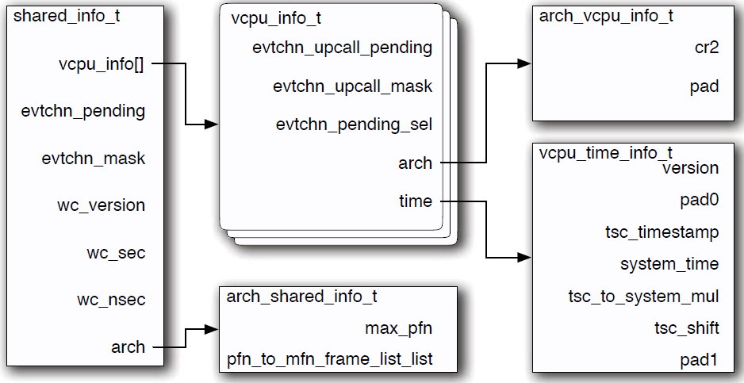
Booting in a Domain
Reference start info page to get the basic information, e.g. available RAM, to boot kernel
Upon kernel running, a shared info page is mapped to the guest kernel to retrieve information about global state
shared info page

Slide 19
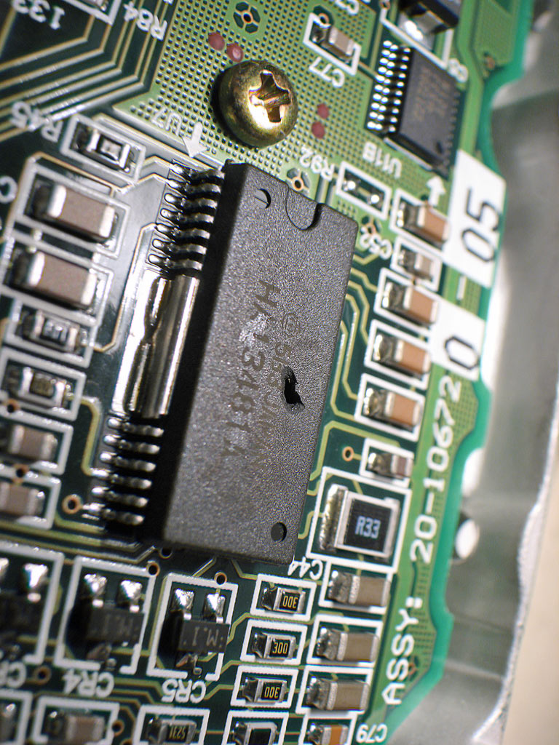
Split Device Driver Model
carg.site.uottawa.ca

Slide 20
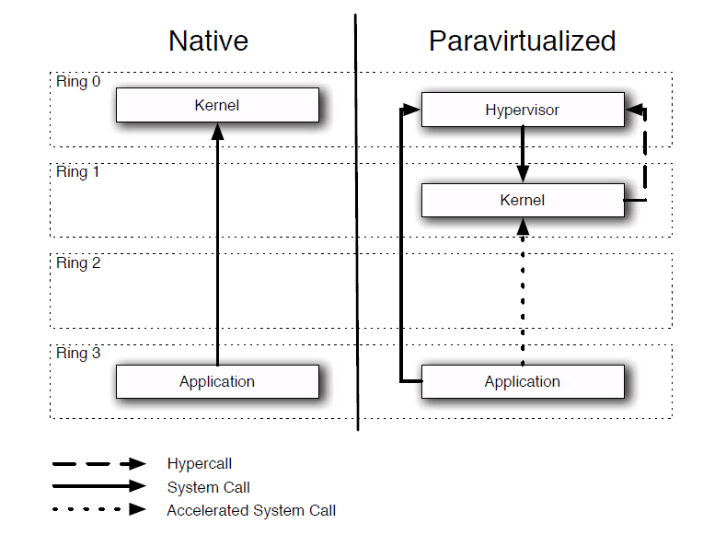
Hypercalls
Requesting services from Xen, e.g. updating page tables
Conceptually similar to system calls, but uses INT 82
carg.site.uottawa.ca

Slide 21
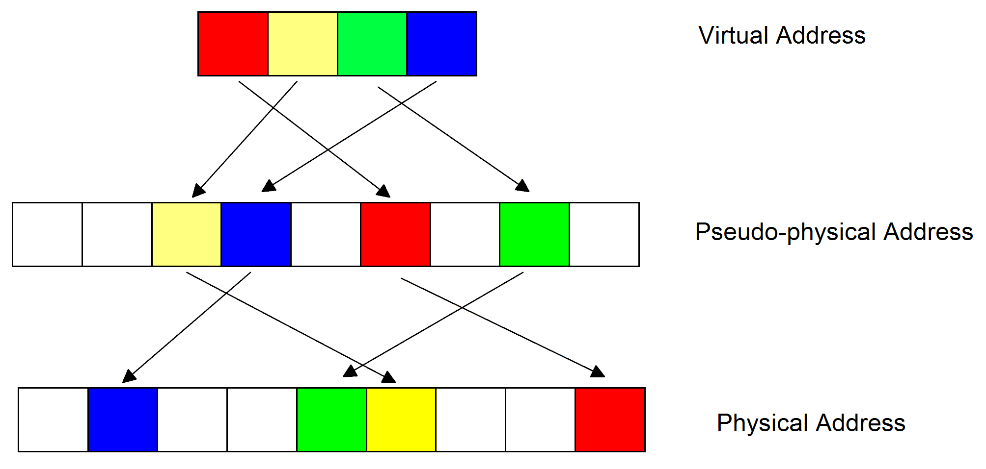
Pseudo-Physical Memory Model
carg.site.uottawa.ca

Slide 22
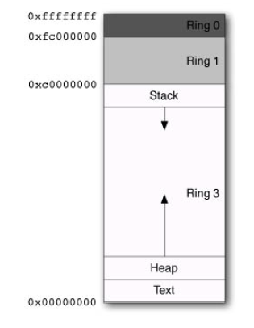

Memory Layout on x86 Systems with Xen
carg.site.uottawa.ca

Slide 23
XenStore
A storage system shared between Xen guests
Maintained by Domain 0 and accessed via a shared memory page and an event channel
Normally used for transferring small amount of data, e.g. metadata
carg.site.uottawa.ca

Slide 24
Grant Tables
Each domain has its own grant table, which is a data structure shared with Xen
Shared pages are identified by an integer, known as a grant reference, which indexes into the grant table
Two operations can be performed via the grant table: mapping or transferringpages
carg.site.uottawa.ca

Slide 25
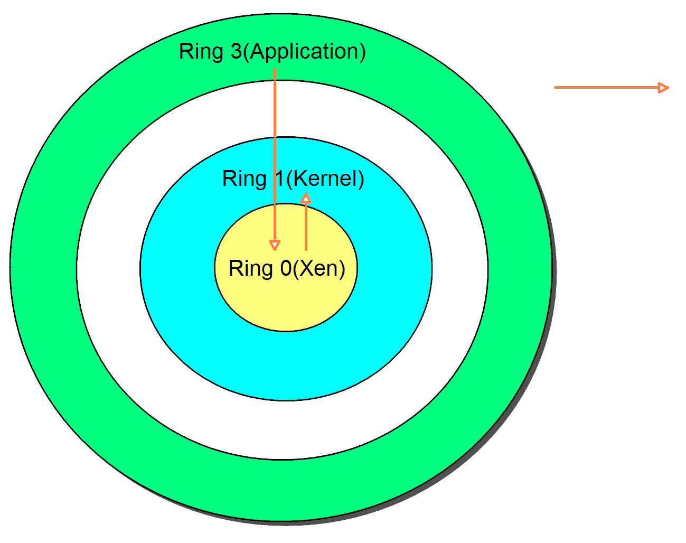
Interrupts
IDT is installed by the Xen, so interrupts are redirected to DomUs, including system calls
System Call
carg.site.uottawa.ca

Slide 26
Events
Xen-specific terminology of virtual interrupts
Conceptually similar to interrupts
Used between domains or between Xen and a domains
Require the setup of an event channel which is maintained by Xen
carg.site.uottawa.ca

Slide 27
Xen Scheduler
Only responsible for allocating CPU resources to domains
Credit Scheduler:
domains are assigned credits according to their weights
credits are debited every 10ms
Scheduling decisions are made every 30ms
Under FIFO queue
Over FIFO queue
carg.site.uottawa.ca

Slide 28
Credit Scheduler Examples
Example: one CPU system, and two Domains-Dom1 (w:2),Dom2 (w:3)
Initial credits: Dom1(c:100), Dom2(c:150)
Time | Running Domain
10ms | Dom1(c:100-50)
20ms | Dom1(c:50-50)
*30ms | Dom1(c:0-50) -> put Dom1() in the Over FIFO queue
40ms | Dom2(c:150-50)
50ms | Dom2(c:100-50)
*60ms | Dom2(c:50-50)-> Allocate credits, Dom1(-50+100), Dom2(C:0+150)
…… | ……
carg.site.uottawa.ca

Slide 29
pvFPGA

Slide 30
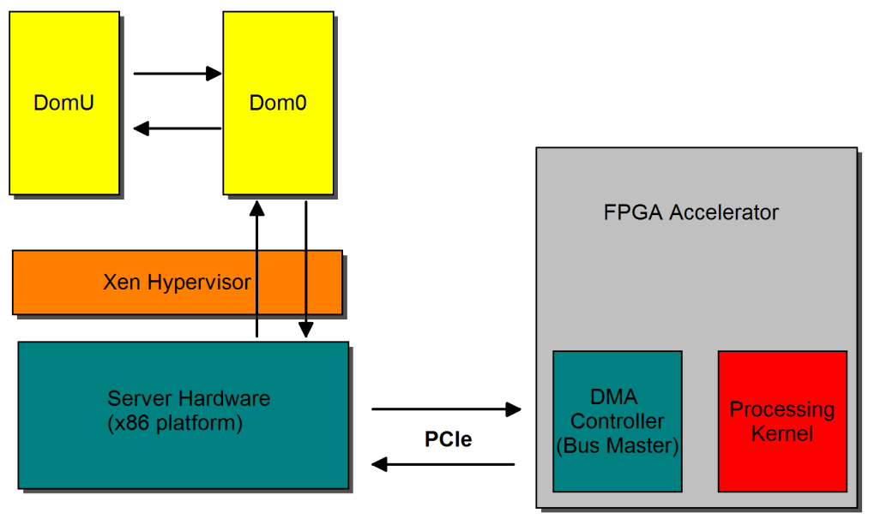
pvFPGA Overview
x86 server : Intel® Xeon Processor W3670 running at 3.2GHZ and 4 GB of main memory
FPGA accelerator: Xilinx Virtex-6 LXT FPGA ML605 Evaluation Kit, 4-lane (Gen 2 ) PCIe interface
Hypervisor: Xen-4.1.2
carg.site.uottawa.ca

Slide 31
Hardware Design (1)
Accelerator Design with one DMA channel
Same color modules operate at the same frequency
DDRII memory is used to store large datasets when the computing procedure involves large amounts of data
carg.site.uottawa.ca

Slide 32
Hardware Design (2)
Accelerator Design with two DMA channels
The DDRII memory can be removed for the majority of applications, since the accelerator reads from the server memory and writes to the server memory simultaneously. That is, we can take advantage of a streaming pipeline
carg.site.uottawa.ca

Slide 33
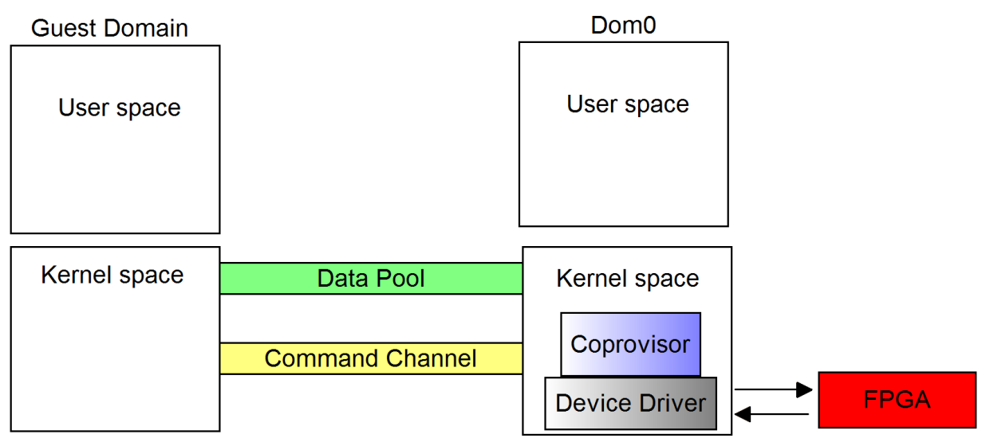
Software Design
Data pool: a shared memory based channel for user-kernel space and inter-domain data transfer (VIP domains are assigned with larger data pool sizes ☺)
Command channel: a shared memory based channel for inter-domain command transfer
Coprovisor: multiplexes simultaneous domain access to the shared FPGA accelerator
carg.site.uottawa.ca

Slide 34

Thank You!

